Slide 1
Presentation on HR Analytics Project
Presented By:
Pradeep Singh Aswal

Slide 2
Table of Content
Introduction about the Problem
Platform to solve the problem
Observation of Datasets
Understand the variables of Dataset
EDA of Datasets
Manage the datasets according to the problem
Data visualization
Selection of Model
Accuracy Check
Conclusion
References

Slide 3
Problem Statement
A company with 4410 employees is given.
Many of the employees leaves the company every year (due to Resignation or Fired)
Due to this company have to face many problems.
The former employees’ projects get delayed, which makes it difficult to meet timelines, resulting in a reputation loss among consumers and partners
A sizeable department has to be maintained, for the purposes of recruiting new talent
More often than not, the new employees have to be trained for the job and/or given time to acclimatise themselves to the company

Slide 4
Problem??
The HR of the company wants the factors which affect the employees.
The factors by which the attrition rate can be decreased.
Which factors are important and useful for the employees.

Slide 5
Platform
We use Jupyter Platform for this problem.
Implemented this code in Python because
Easy to implement
Visualization is good
The coding is easy
Has all the Libraries

Slide 6
Datasets
In this problem statement 5 Datasets are given to us
Employee survey data
General data
Manager survey data
In-time
Out-time

Slide 7
General Dataset
It consist of 24 Columns
Age
Attrition
BusinessTravel
Department
DistanceFromHome
Education
EducationField
EmployeeCount
EmployeeID
Gender
JobLevel
JobRole
MaritalStatus
MonthlyIncome
NumCompaniesWorked
Over18
PercentSalaryHike
StandardHours
StockOptionLevel
TotalWorkingYears
TrainingTimesLastYear
YearsAtCompany
YearsSinceLastPromotion
YearsWithCurrManager
From the above slide we can conclude that in general data set all general entries are recorded.

Slide 8
Employee Dataset
It consists of 4 columns
EmployeeID -4410 Entries (Non-null)
EnvironmentSatisfaction -4385 Entries (Non-null )
JobSatisfaction -4390 Entries (Non –null)
WorkLifeBalance - 4372 Entries (Non-null)
From this we can see that in this database there are some missing values in last three columns.

Slide 9
Manager Dataset
It consists of Three columns
EmployeeID 4410 Entries (Non-null)
JobInvolvement 4410 Entries ( Non-null)
PerformanceRating 4410 Entries (Non – null)
From this database we can see that no column contain any null values.

Slide 10
In time & Out time datasets
These datasets consists of Intime and Outtime of each employee according to date.
One Unnamed Column is also there which acts like an index number.

Slide 11
EDA Process
In EDA Process the steps follows are:-
First check the datasets by the “Dataset.head()” command.
We make two list, in which one is made of all three databases. And other is made up of two in time and out time databases.
data = [general,employee,manager] log_time=[intime,outtime]
For getting the information from list we run a for loop for that.
From this we find that the Employee ID is acts like a Primary key in all the databases.

Slide 12
EDA Process
Checking that all the databases have equal records.
With the help of employee id we can check the unique values in all the datasets.
The In time and Out time data sets are also contain “Unnamed Column” that is also of same range.
After Checking the length oh Unnamed Column we convert it into the “Employee ID” Column.
“intime.rename(columns={'Unnamed: 0':'EmployeeID'} , inplace = True)”

Slide 13
EDA Process
Now all 5 datasets have “Employee ID “ and the length is 4410.
The In_time and Out_time Dataset are not properly arranged so for that we have to manage that data.
We are transposing the data so that calculations can be done easily.
Before transpose the dataset column is like- “Employee Id”, Date , Date …..,Date.
After Transpose the dataset is like – Employee ID, 1,2 ,3,…4410.

Slide 14
EDA Process
After that we merge all the five dataset into one.
Add one variable into the main dataset “Average overtime”
The +ve value shows the Overtime and the –ve value shows the Undertime.
Next step is the dealing with the missing values
By using the “ is.na().sum()” we found the variables which have missing values.

Slide 15
Checking Null Values
The missing values status:-
NumCompaniesWorked - 19
EnvironmentSatisfaction - 25
JobSatisfaction - 20
WorkLifeBalance - 38
TotalWorkingYears – 9
We will drop these missing values from the dataset because the percentage of missing value is less than 3%. So we can drop them.

Slide 16
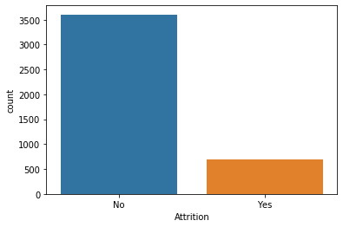
Data Visualization
With the help of Attrition Variable we found that around 16% of Employees already left the company.
Graph shows the Attrition of employees.

Slide 17
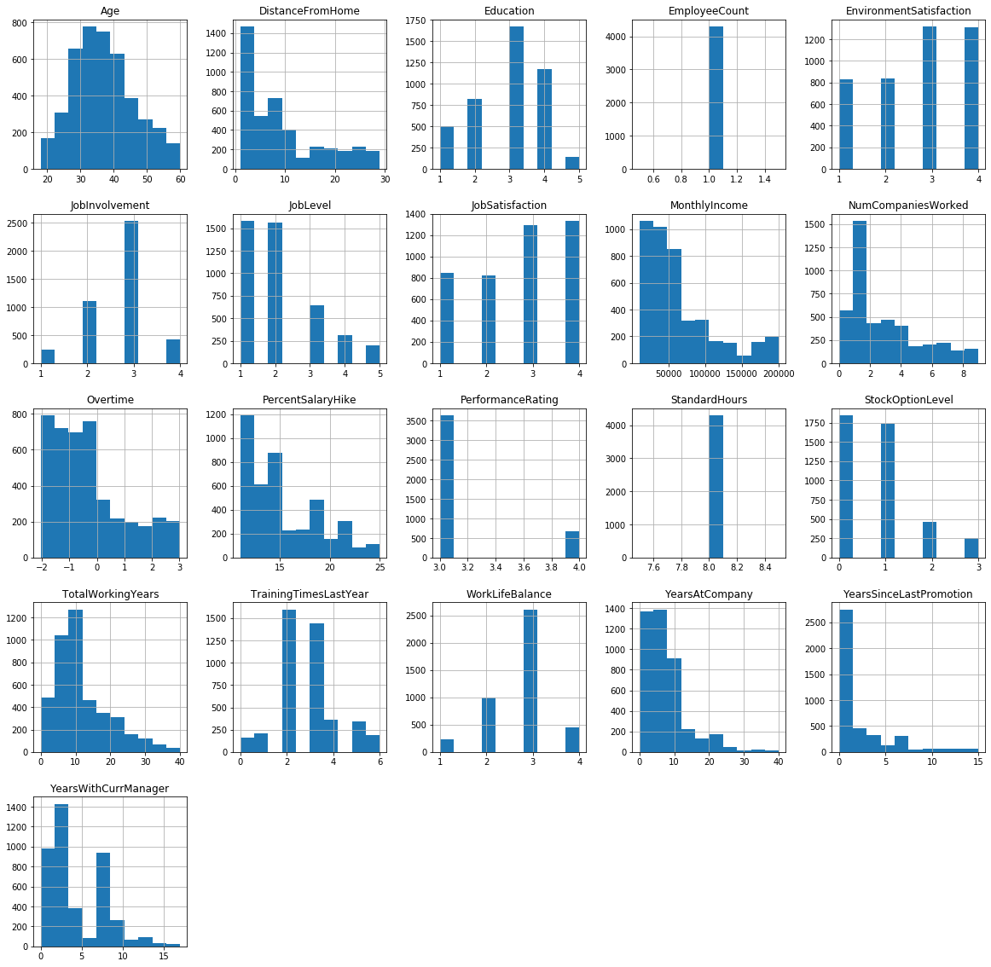
Data Visualization
Try to find out the important variable with the help of histogram diagram

Slide 18
Data Visualization
With the help of histogram we found that these variables are not important:-
Over18
Standard Hours
Employee Count
So we Drop these variable from our datasets
In next Step we will see the co-relation between all the variables with the help of graph.

Slide 19
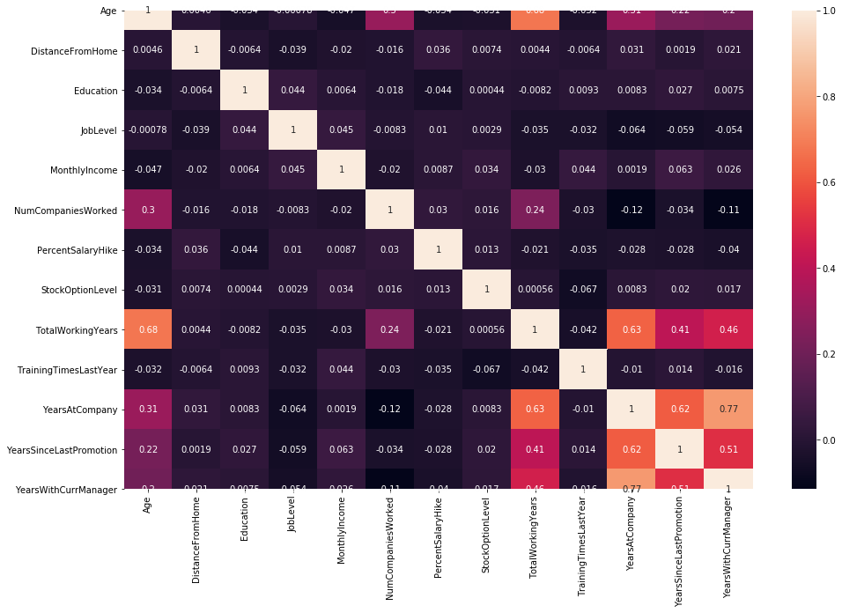
Co-relation graph

Slide 20
Data Visualization
In the numerical data visualization we have found that the variable “Frequency of Travel” tell us that the employees which travels more are leaving the company very frequently
Employees which have Job level category 1 and 2 are frequently leaving the company.
Employees age between 29 – 31 are leaving the company very frequently.

Slide 21
Selection of Model
We have selected the Random Forest Model for this problem
The reason for selecting this model are –
The random forest technique can handle large data sets due to its capability to work with many variables running to thousands.
The problem statement is classification Problem
Ensemble Model
Performance Matrix Such as- Precision, Recall, F1- Score

Slide 22
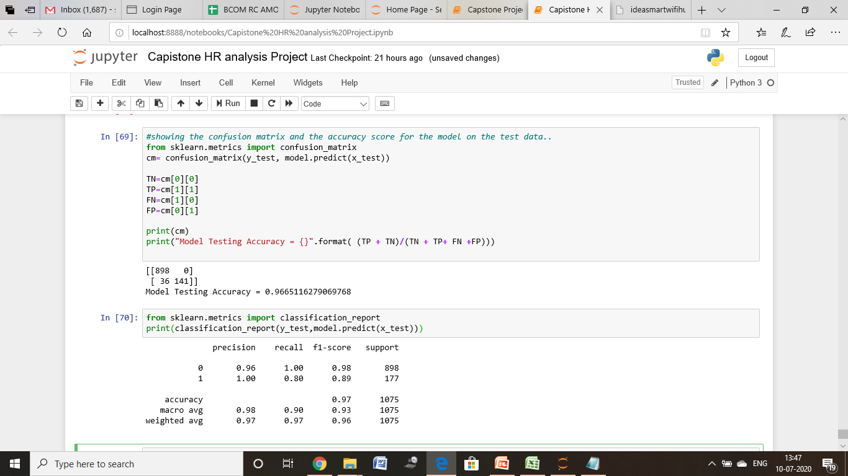
Accuracy Check
We split the dataset in Train and Test Split.
Use random forest classifier Model
The accuracy of training data is = 0.9975
According to Confusion Matrix the accuracy of predicted model is 0.966
Classification Report of Model

Slide 23
Conclusion
Factors that increase attrition rate are:
Department Frequency of travel Job level Marital status Distance from working location Overtime and personal life balance
Factors that can decrease attrition includes:
Appraisal as per performance rating Internal job posting (IJP) Learning and development Salary hike

Slide 24
References
Imarticus online learning Platform
Youtube Channel
Statquest with Josh Starner
http://corporatefinanceinstitute.com/
http://theprofessionalspoint.blogspot.com

Slide 25
Thank You

